Slide 1
Restricted Boltzmann Machine
(RBM)

Slide 2
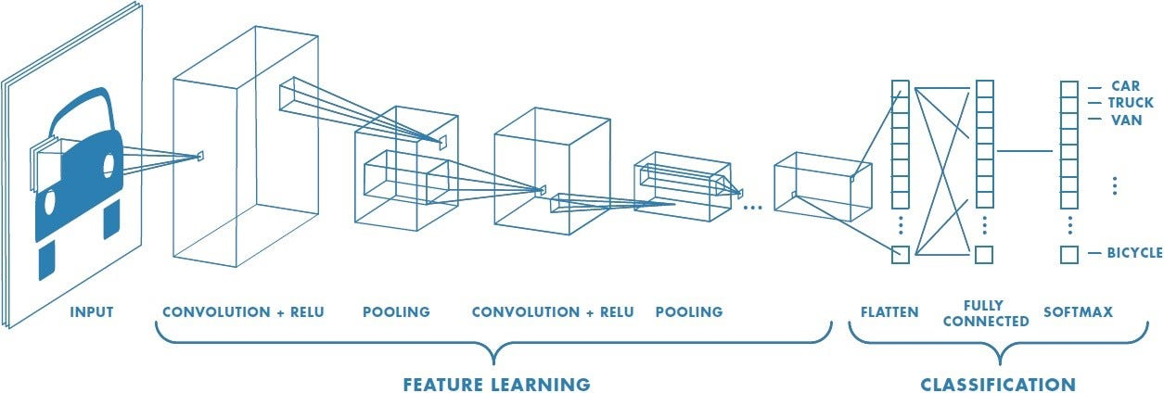

Slide 3
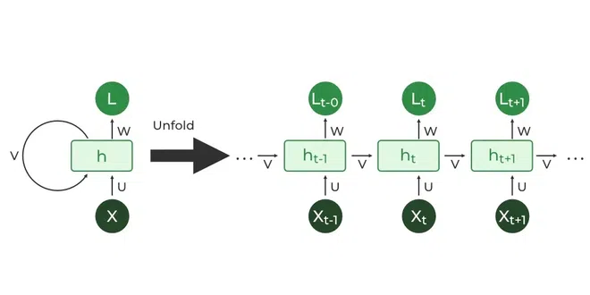

Slide 4
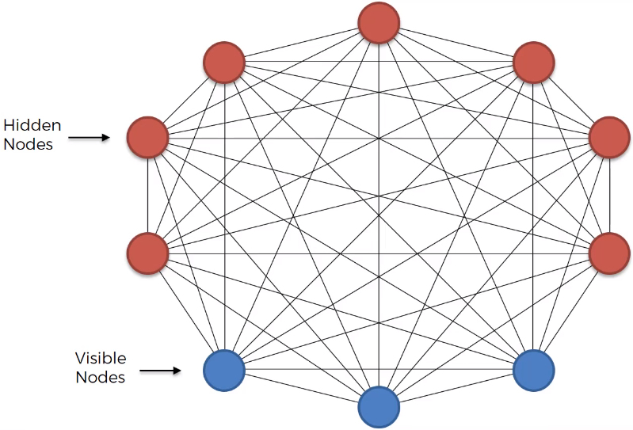

Slide 5
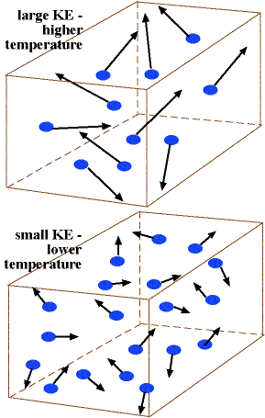

Slide 6
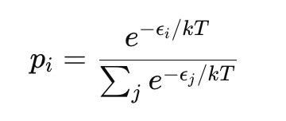
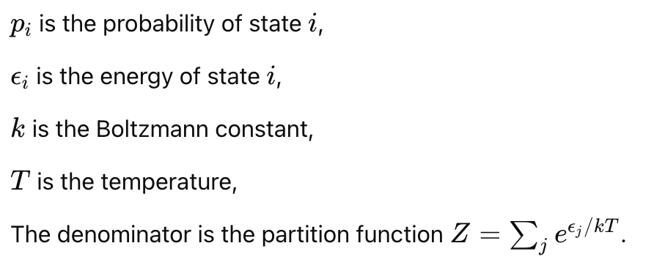
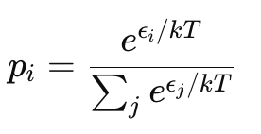

Slide 7
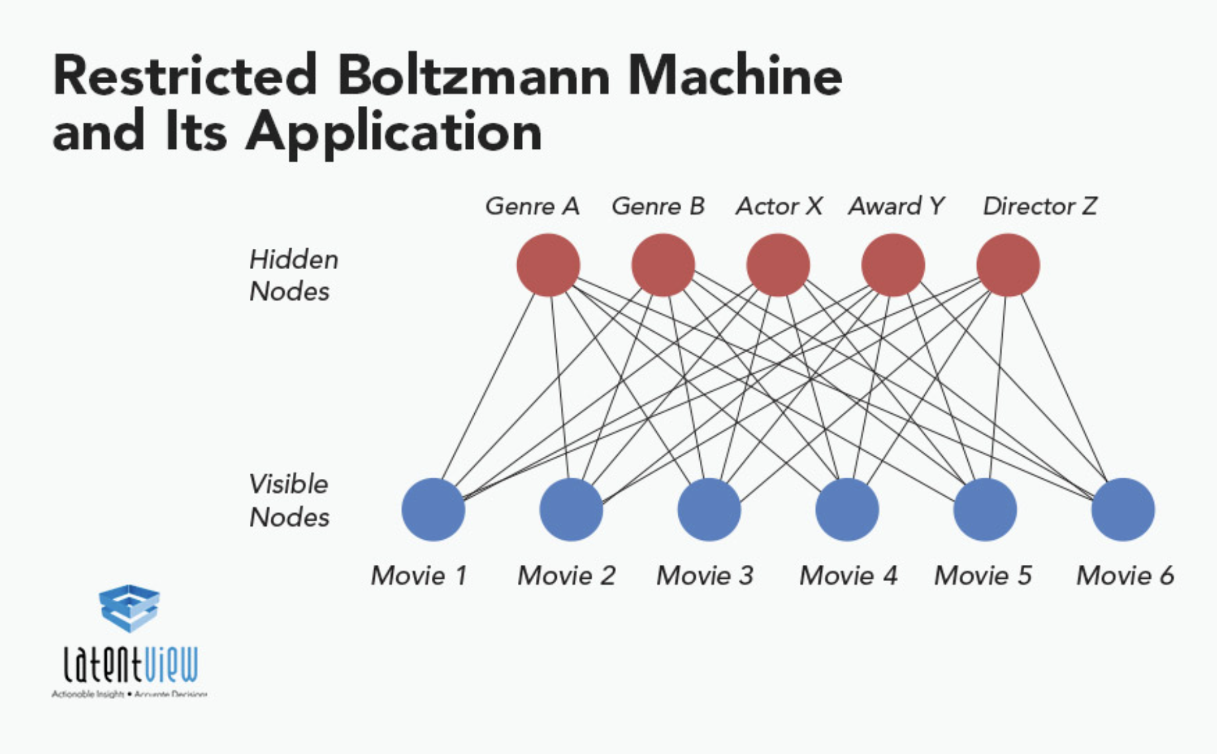

Slide 8
 | Movie 1 | Movie 2 | Movie 3 | Movie 4 | Movie 5
User 1 | 1 | 0 | 1 | 0 | 0
User 2 | 0 | 1 | 1 | 1 | 1
User 3 | 1 | 1 | 0 | 0 | 1

Slide 9
Contrastive Divergence

Slide 10
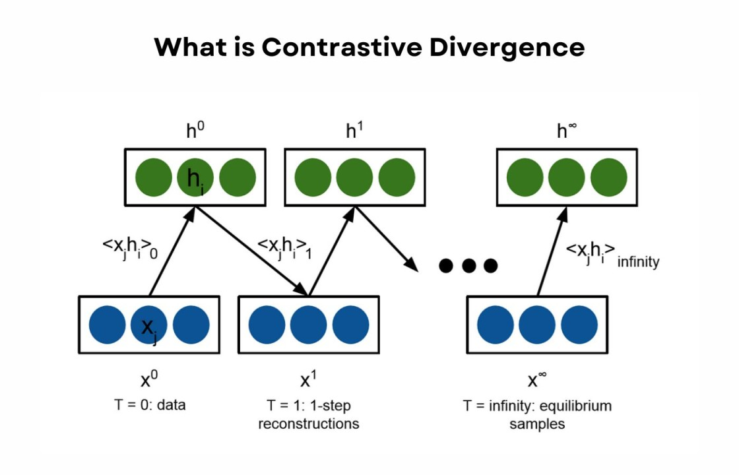

Slide 11
Momentum

Slide 12
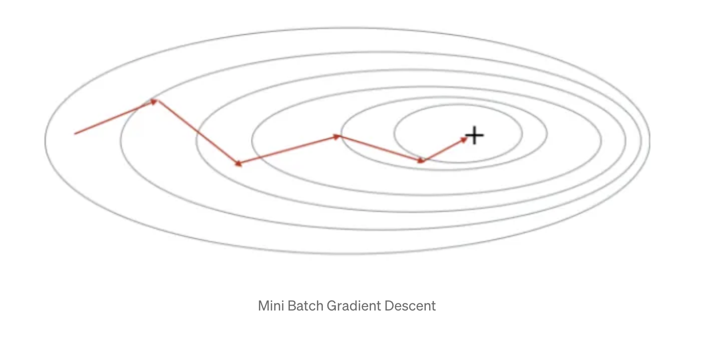
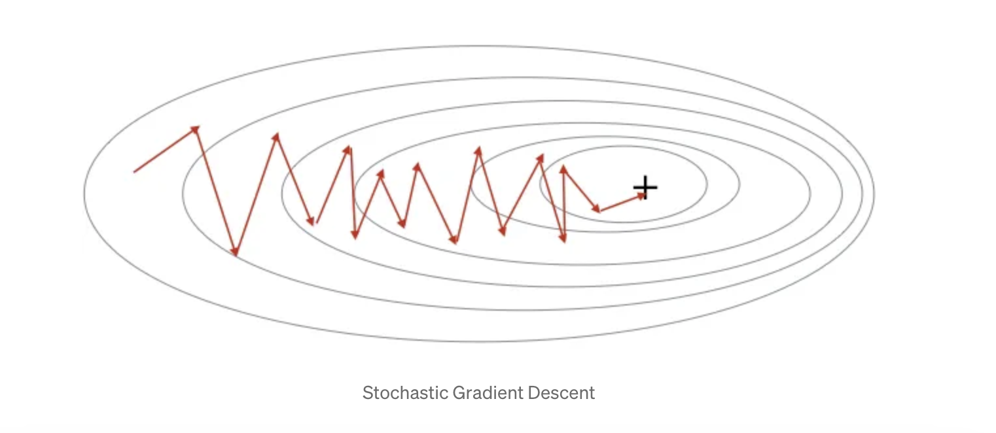

Slide 13
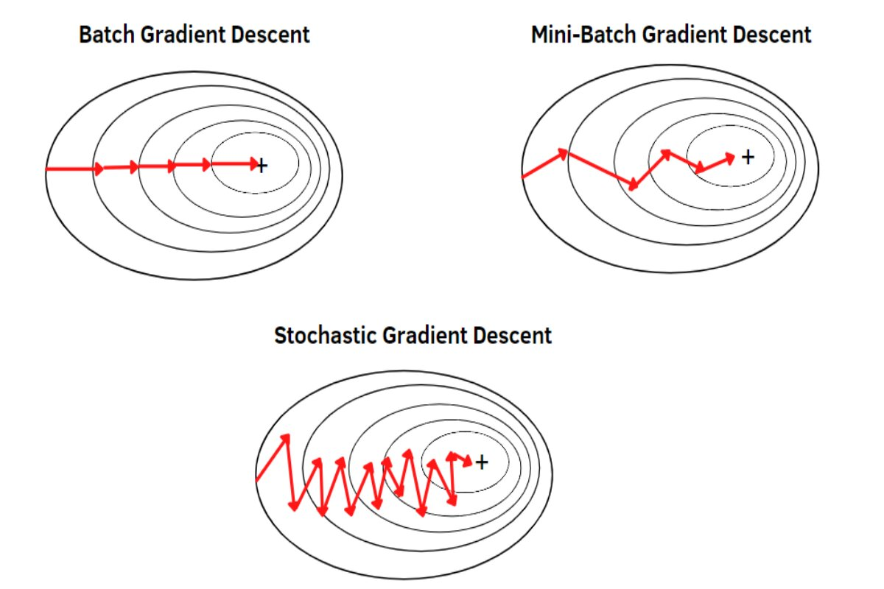

Slide 14
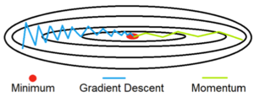

Slide 15
Exponentially Weighted Moving Average

Slide 16
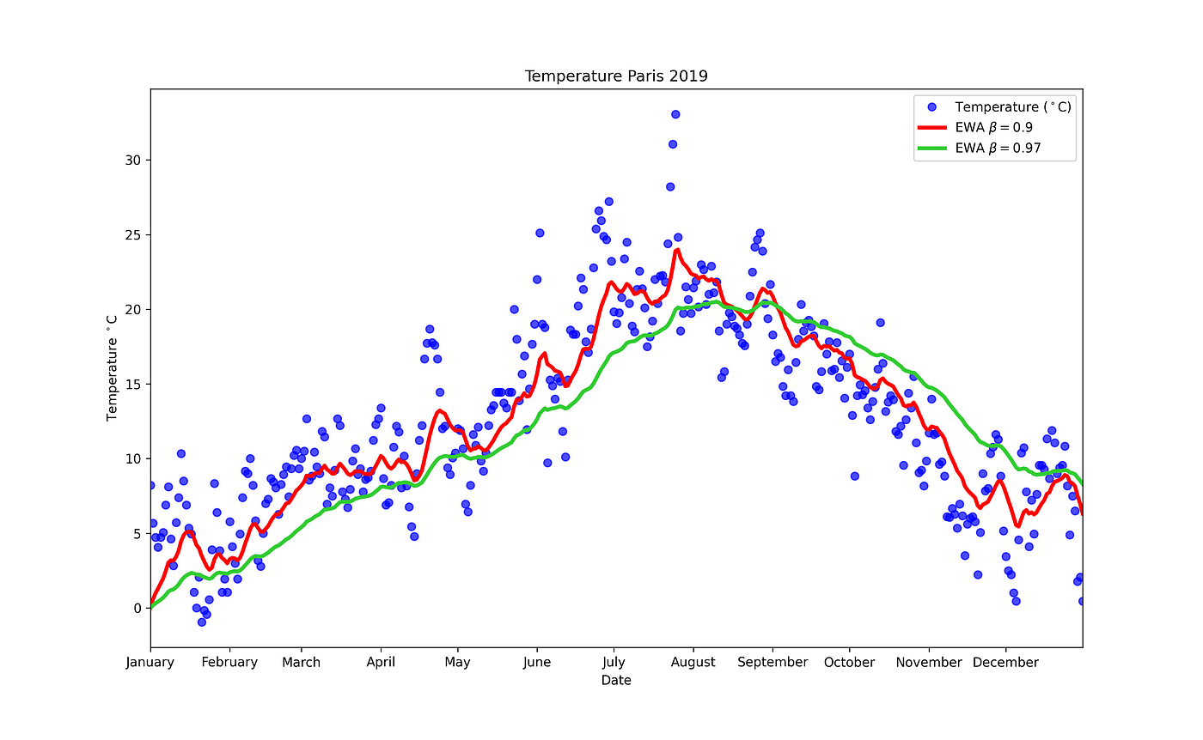

Slide 17
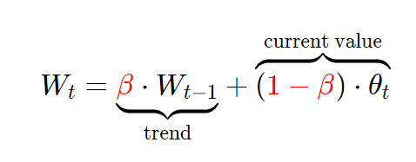
V_{t-1}
V_{t}

Slide 18

V_{t}
V_{t-1}

Slide 19


V_{t}
V_{t-1}

Slide 20

V_{t}
V_{t-1}

Slide 21

V_{t}
V_{t-1}

Slide 22


Slide 23


Slide 25
